Slide 1

資料結構 Data Structure
Chap.02 Arrays and Structures
Ming-Han Tsai
2022 Fall

Slide 2
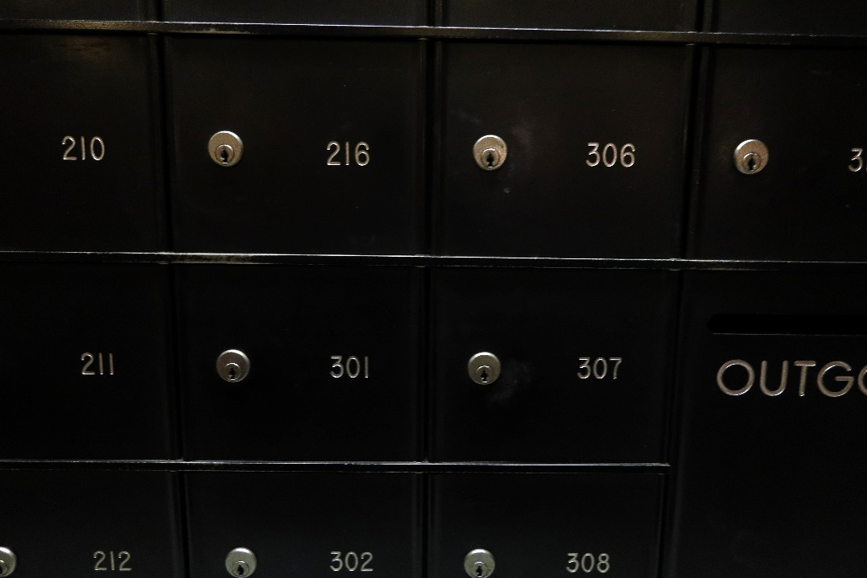
陣列(Array)
陣列(array)由一連串的索引(index)和值(value)構成
對每個索引index，必有一個相關聯的值value
如果可能的話，盡量使用連續空間的記憶體
減少存取時間

Slide 3
Abstract Data Type Array
objects：A set of pairs <index, value> where for each value of index there is a value from the set item. Index is a finite ordered set of one or more dimensions, for example, {0, … , n-1} for one dimension, {(0,0),(0,1),(1,0),(1,1),(2,0),(2,1)} for two dimensions, etc.
Functions：for all A ϵ Array, i ϵ index, x ϵ item, j, size ϵ integer
Array Create(j, list)
Item Retrieve(A, i)
Array Store(A, i, x)
::= return an array of j dimensions where list is a j-tuple whose ith element is the size of the ith dimension. Items are undefined.
::= if (i ϵ index) return the item associated with index value i in array A
else return error
::= if (i in index) return an array that is identical to array A except the new pair <i, x> has been inserted
else return error

Slide 4
Arrays in C
int list[5], *plist[5];
list[5]: 名為list的陣列，類型為int，長度為5
list[0], list[1], list[2], list[3], list[4]
*plist[5]: 名為plist的陣列，類型為int pointer，長度為5
plist[0], plist[1], plist[2], plist[3], plist[4]
Implementation of 1-D array’
list[0] base address = α
list[1] α + sizeof(int)
list[2] α + 2*sizeof(int)
list[3] α + 3*sizeof(int)
list[4] α + 4*size(int)
記憶體
α
list
α
α+4
α+8
α+12
α+16
Notes:
C語言中的陣列適用指標實作的

Slide 5
Arrays in C
在C語言中，[]和* 其實有類似的意義
int *list1 和 int list2[5]
相同處: list1 和 list2 都是指標(pointer)
不同處: list2 保留了五個整數的空間
標記:
list2 ： a pointer to list2[0]
(list2 + i) ： a pointer to list2[i] (&list2[i])
*(list2 + i) ： list2[i]
&：取址(address)
*：取值(value)

Slide 6
Example: 1-dimension array addressing
int one[] = {0, 1, 2, 3, 4};
Goal: print out address and value
void print1(int *ptr, int rows)
{
/* print out a one-dimensional array using a pointer */
int i;
printf(“Address Contents\n”);
for (i=0; i < rows; i++)
printf(“%8u%5d\n”, ptr+i, *(ptr+i));
printf(“\n”);
}

Slide 7
記憶體
int one[] = {0, 1, 2, 3, 4};
α
one
α
α+2
α+4
α+6
α+8

Slide 8
Structures (records)
struct {
char name[10];
int age;
float salary;
} person;
strcpy(person.name, “james”);
person.age=10;
person.salary=35000;
只宣告了一筆叫person的紀錄，型態為struct
無法再利用

Slide 9
Create structure data type
typedef struct human_being {
char name[10];
int age;
float salary;
};
human_being person1, person2;
typedef struct {
char name[10];
int age;
float salary
} human_being;
or
宣告了一個叫human_being的資料型態
宣告了兩筆叫person1、person2的紀錄，型態為human_being

Slide 10
Unions
類似於struct，但裡面所有資料共用記憶體空間，永遠只會有一個欄位有值(active)
Example: Add fields for male and female.
typedef struct sex_type {
enum tag_field {female, male} sex;
union {
int children;
int beard;
} u;
};
typedef struct human_being {
char name[10];
int age;
float salary;
date dob;
sex_type sex_info;
}
← enum：列舉，表示可以用female/male代替0/1
human_being person1, person2;
person1.sex_info.sex=male;
person1.sex_info.u.beard=FALSE;
print(person1.sex_info.u.children); ←無意義

Slide 11
Array/Struct/Union/Enum
Array：連續記憶體空間，同一類型的資料
Struct：不同類型的資料組合而成的一種自定義的資料型態，每個資料佔一個記憶體 = 同時都可以使用
Union：不同類型的資料組合而成的一種自定義的資料型態，但多筆資料共用同一小塊記憶體 = 同時只有一個資料能用
Enum：列舉代號讓程式更簡潔
struct human {
enum{female,male} sex;
char[20] name;
int name;
};
Struct
Union
INT
CHAR[20]
CHAR[20]
INT

Slide 12
Self-Referential Structures
結構(struct)中包含指向自己類型的指標(pointer)
typedef struct list {
char data;
list *link;
}
list item1, item2, item3;
item1.data=‘a’;
item2.data=‘b’;
item3.data=‘c’;
item1.link=item2.link=item3.link=NULL;
item1.link = &item2;
item2.link = &item3;
Struct list
Type:int
Type:*list
Construct a list with three nodes
item1.link=&item2;
item2.link=&item3;
malloc: obtain a node
a
b
c

Slide 13
Ordered List Examples
考慮某些情況下，我們需要序列：(item1,item2,item3,…,itemN)
(水星、金星、地球、火星、木星、土星、天王星、海王星)
(2,3,4,5,6,7,8,9,10,J,Q,K,A)
(2010,2011,2012,…2020)

Slide 14
Ordered List的常見操作
找出List的長度n
從左到右(或是從右到左)循序讀取每一筆資料
擷取第i筆資料
儲存新的資料在i位置(修改)
插入新的資料在i位置，使得i以後的元素ai, ai+1,ai+2,…,an 變成ai+1,ai+2,…,an+1(新增)
刪除某一筆位於i的資料，使得i以後的元素ai, ai+1,ai+2,…,an 變成ai-1,ai-2,…,an-1
Think：Array辦的到嗎？
(1) ~ (4) Yes
(5)~(6) No

Slide 15
Recall：
Ex: 建立一個可以儲存紀錄全班每個人成績的程式
int s9885123 = 90;
int s9885124 = 88;
int s9001245 = 79;
int sg[1000000];
sg[9885123] = 90;
sg[9885124] = 88;
sg[9001245] = 79;
Student A[40];
A[0].ID = 9885123;
A[0].grade = 90;
…

Slide 16
多項式表示法
思考：多項式表示法&加法&乘法
F(x) = x^100 + x^10 + 4x + 1
G(x) = x^35 + x^34 + x^2+24
F(x) + G(x) = ?
F(x) * G(x) = ?
怎麼用程式表示？

Slide 17
ADT Polynomial是 物件： p(x) ＝ a₁x^{e1}＋ ... ＋a_{n}x^{en}; 一個成對序集 <e_{i}, a_{i}>，其中 a_{i} 屬於Coefficients，e_{i} 屬於Exponents，e_{i}是大於或等於零的整數 函式： 對於所有的poly, poly1, poly2 ∈Polynomial，coef ∈Coefficients，expon∈Exponents
Polynomial Zero() | ::= | return 多項式，p(x) = 0
Boolean IsZero(poly) | ::= | if(poly) return FALSE else return TRUE
Coefficient Coef(poly,expon) | ::= | if(expon ∈ poly) return它的係數 else return 0
Exponent LeadExp(poly) | ::= | return poly的最高次方
Polynomial Attach(poly,coef,expon) | ::= | if(expon ∈ poly) return錯誤 else return 插入<coef,expon>之後的多項式 poly
Polynomial Remove(poly,expon) | ::= | if(expon ∈ poly) return刪除次方是expon的項後的多項式poly else return錯誤
Polynomial SingleMult(poly,coef,expon) | ::= | return 多項式 poly．coef．x^{expon}
Polynomial Add(poly1,poly2) | ::= | return 多項式 poly1＋poly2
Polynomial Mult(poly1,poly2) | ::= | return 多項式 poly1．poly2

Slide 18
多項式加法
F(x) = x^100 + x^10 + 4x + 1
G(x) = x^35 + x^34 + x^2+24
F(x) + G(x) = ?
怎麼用程式表示？

Slide 19
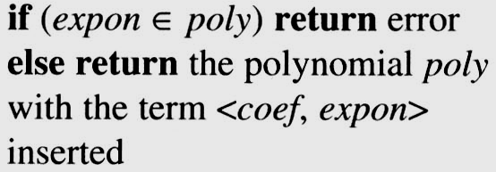
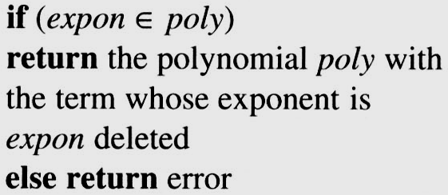
Polynomial Addition
/* d =a + b, where a, b, and d are polynomials */ d = Zero( ) while (! IsZero(a) && ! IsZero(b)) do { switch ( COMPARE (Lead_Exp(a), Lead_Exp(b) ) { case -1: d=Attach(d, Coef (b, Lead_Exp(b)), Lead_Exp(b)); b = Remove(b, Lead_Exp(b)); break; case 0: sum = Coef (a, Lead_Exp (a)) + Coef ( b, Lead_Exp(b)); if (sum) { Attach (d, sum, Lead_Exp(a)); a = Remove(a , Lead_Exp(a)); b = Remove(b , Lead_Exp(b)); } break; case 1: d=Attach(d, Coef (a, Lead_Exp(a)), Lead_Exp(a)); a = Remove(a, Lead_Exp(a)); } }
insert any remaining terms of a or b into d
*Program 2.4 :Initial version of padd function(p.62)
advantage: easy implementation
disadvantage: waste space when sparse

Slide 20
EX: A(x) = 3x²⁰+2x⁵+4 and B(x) = x⁴+10x³+3x²+1
D(x) = A(x) + B(x)
d = Zero( ) ; // Let d is a Null polynomial
while (! IsZero(a) && ! IsZero(b)) do { switch ( COMPARE (Lead_Exp(a), Lead_Exp(b) ) { case -1: d = Attach(d, Coef (b, Lead_Exp(b)), Lead_Exp(b)); b = Remove(b, Lead_Exp(b)); break; case 0: sum = Coef (a, Lead_Exp (a)) + Coef ( b, Lead_Exp(b)); if (sum) { Attach (d, sum, Lead_Exp(a)); a = Remove(a , Lead_Exp(a)); b = Remove(b , Lead_Exp(b)); } break; case 1: d = Attach(d, Coef (a, Lead_Exp(a)), Lead_Exp(a)); a = Remove(a, Lead_Exp(a)); }
}
A(x) = ZERO
B(x) = ZERO
A(x) = ZERO
B(x) = ZERO
D(x) = 3x²⁰+2x⁵+x⁴+10x³+3x²+5
A(x) = 3x²⁰+2x⁵+4
B(x) = x⁴+10x³+3x²+1
A(x) != ZERO B(x) != ZERO
A(x) = 3x²⁰+2x⁵+4
B(x) = x⁴+10x³+3x²+1
Lead_Exp(a) = 20 > Lead_Exp(b) = 4
A(x) = 3x²⁰+2x⁵+4
B(x) = x⁴+10x³+3x²+1
D(x) = 3x²⁰
A(x) = 2x⁵+4
B(x) = x⁴+10x³+3x²+1
D(x) = 3x²⁰
A(x) = 2x⁵+4
B(x) = x⁴+10x³+3x²+1
A(x) != ZERO B(x) != ZERO
A(x) = 2x⁵+4
B(x) = x⁴+10x³+3x²+1
Lead_Exp(a) = 5 > Lead_Exp(b) = 4
A(x) = 2x⁵+4
B(x) = x⁴+10x³+3x²+1
D(x) = 3x²⁰ ⁺ 2x⁵
A(x) = 4
B(x) = x⁴+10x³+3x²+1
D(x) = 3x²⁰ ⁺ 2x⁵
A(x) = 4
B(x) = x⁴+10x³+3x²+1
A(x) != ZERO B(x) != ZERO
A(x) = 4
B(x) = x⁴+10x³+3x²+1
Lead_Exp(a) = 0 < Lead_Exp(b) != 4
A(x) = 4
B(x) = x⁴+10x³+3x²+1
D(x) = 3x²⁰+2x⁵ ⁺ x⁴
A(x) = 4
B(x) = 10x³+3x²+1
D(x) = 3x²⁰+2x⁵ ⁺ x⁴
A(x) = 4
B(x) = 10x³+3x²+1
A(x) != ZERO B(x) != ZERO
A(x) = 4
B(x) = 10x³+3x²+1
Lead_Exp(a) = 0 < Lead_Exp(b) = 3
A(x) = 4
B(x) = 10x³+3x²+1
D(x) = 3x²⁰+2x⁵ + x⁴+10x³
A(x) = 4
B(x) = 3x²+1
D(x) = 3x²⁰+2x⁵ + x⁴+10x³
A(x) = 4
B(x) = 3x²+1
A(x) != ZERO B(x) != ZERO
A(x) = 4
B(x) = 3x²+1
Lead_Exp(a) = 0 < Lead_Exp(b) = 2
A(x) = 4
B(x) = 3x²+1
D(x) = 3x²⁰+2x⁵ +x⁴+10x³+3x²
A(x) = 4
B(x) = 1
D(x) = 3x²⁰+2x⁵ +x⁴+10x³+3x²
A(x) = 4
B(x) = 1
A(x) != ZERO B(x) != ZERO
A(x) = 4
B(x) = 1
Lead_Exp(a) = 0 == Lead_Exp(b) = 0
A(x) = 4
B(x) = 1
Sum(x) = A(x) + B(x) = 4 + 1 = 5
A(x) = 4
B(x) = 1
D(x) = 3x²⁰+2x⁵+x⁴+10x³+3x²+5

Slide 21
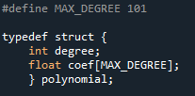

Typedef polynormial：
陣列表示
Struct 表示法1：
$$a.degree=n$$
$$a.coef\left[i\right]= a_{n−1},0≤i≤n$$
缺點：這個表示法
很浪費空間!!

Slide 22
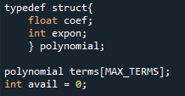

Typedef polynormial：
Struct 表示法2：
$avail：$有用到的項的數目
$$terms\left[i\right].expon=p$$
$$terms\left[i\right].coef= a_{i} for a_{i}x^{p}$$

Slide 23
Typedef polynormial：
Struct 表示法2：
$avail：$有用到的項的數目
$$terms\left[i\right].expon=p$$
$$terms\left[i\right].coef= a_{i} for a_{i}x^{p}$$

Slide 24
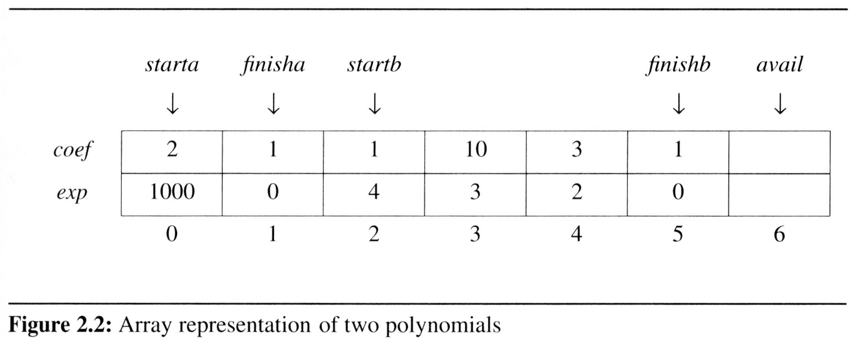
Typedef polynormial：
用單一個大陣列儲存所有的多項式
specification representation
poly <start, finish>
A <0,1>
B <2,5>
A(x) = 2x¹⁰⁰⁰+1
B(x) = x⁴+10x³+3x²+1
storage requirements: start, finish, 2*(finish-start+1)

Slide 25
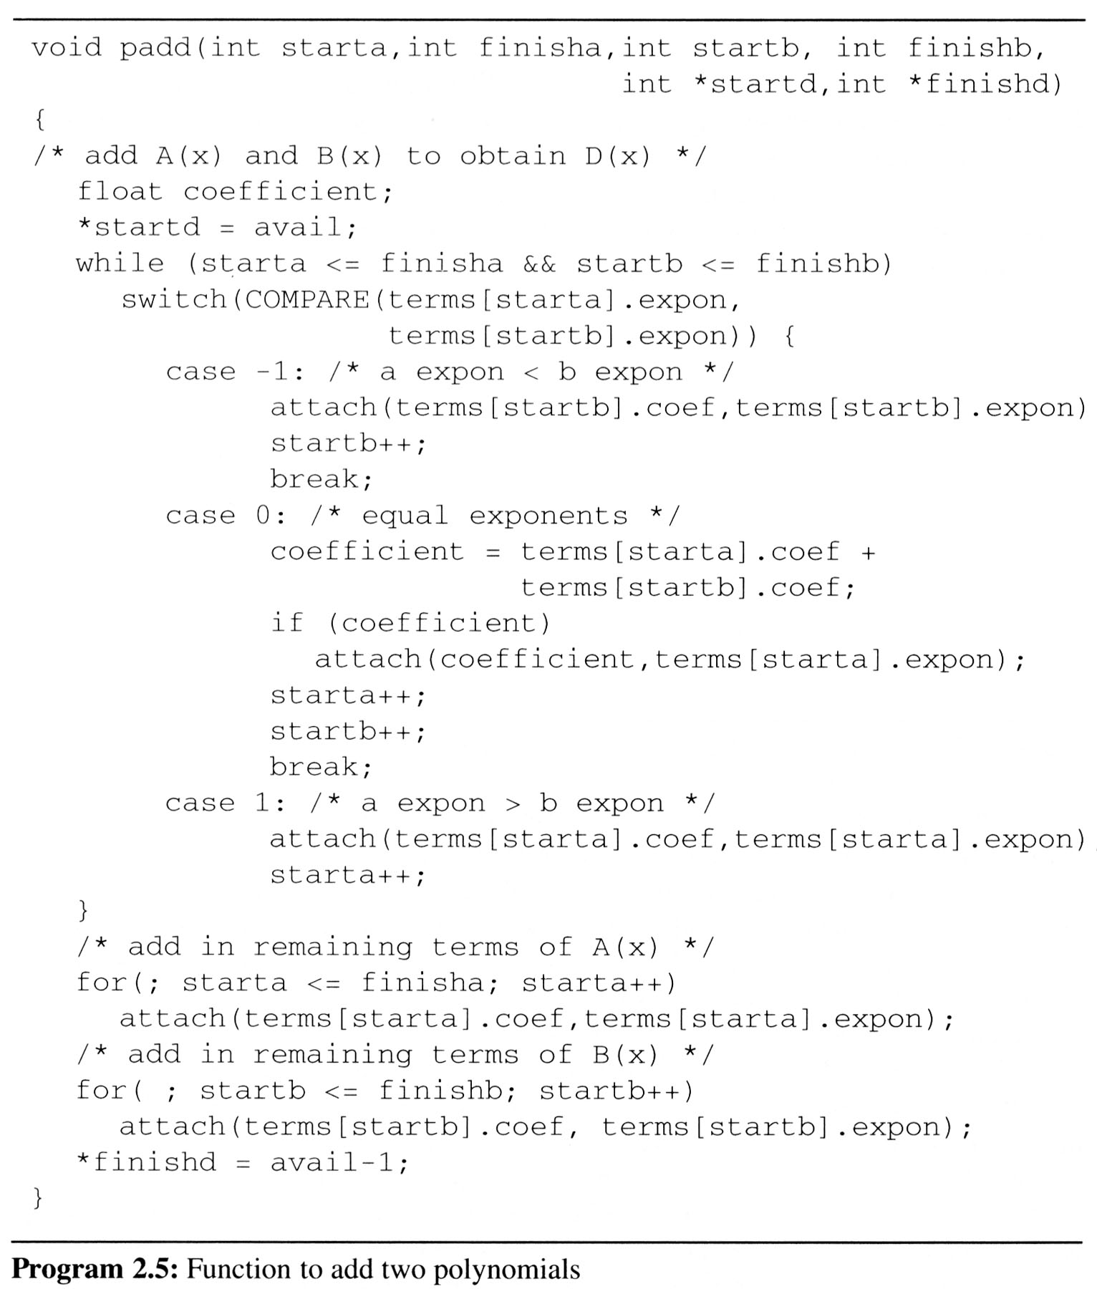
如何用C語言表示一個能將AB相加的函數padd，並將結果儲存在D：D = A + B.
To produce D(x), padd (Program 2.5) adds A(x) and B(x) term by term.
Analysis: O(n+m)
where n (m) is the number of nonzeros in A (B).

Slide 26
A(x) = 2x¹⁰⁰⁰+1
B(x) = x4+10x3+3x2+1
starta = 0 finisha = 1
startb = 2 finishb = 5
starta <= finisha = TRUE
startb <= finishb = TRUE
A(x) = 2x¹⁰⁰⁰+1
B(x) = x4+10x3+3x2+1
term[starta].expon = 1000 > term[startb].expon = 4
A(x) = 2x¹⁰⁰⁰+1
B(x) = x⁴+10x³+3x²+1
starta ++ ;
starta = 1;
A(x) = 2x¹⁰⁰⁰+1
B(x) = x4+10x3+3x2+1
starta = 1 finisha = 1
startb = 2 finishb = 5
starta <= finisha = TRUE
startb <= finishb = TRUE
A(x) = 2x¹⁰⁰⁰+1
B(x) = x4+10x3+3x2+1
term[starta].expon = 0 > term[startb]. expon = 4
A(x) = 2x¹⁰⁰⁰+1
B(x) = x⁴+10x³+3x²+1
startb++ ;
startb = 3;
A(x) = 2x¹⁰⁰⁰+1
B(x) = x4+10x3+3x2+1
starta = 1 finisha = 1
startb = 3 finishb = 5
starta <= finisha = TRUE
startb <= finishb = TRUE
A(x) = 2x¹⁰⁰⁰+1
B(x) = x4+10x3+3x2+1
term[starta].expon = 0 < term[startb]. expon = 3
A(x) = 2x¹⁰⁰⁰+1
B(x) = x⁴+10x³+3x²+1
startb++ ;
startb = 4;
A(x) = 2x¹⁰⁰⁰+1
B(x) = x4+10x3+3x2+1
starta = 1 finisha = 1
startb = 4 finishb = 5
starta <= finisha = TRUE
startb <= finishb = TRUE
A(x) = 2x¹⁰⁰⁰+1
B(x) = x4+10x3+3x2+1
term[starta].expon = 0 < term[startb]. expon = 2
A(x) = 2x¹⁰⁰⁰+1
B(x) = x⁴+10x³+3x²+1
startb++ ;
startb = 5;
A(x) = 2x¹⁰⁰⁰+1
B(x) = x4+10x3+3x2+1
starta = 1 finisha = 1
startb = 5 finishb = 5
starta <= finisha = TRUE
startb <= finishb = TRUE
A(x) = 2x¹⁰⁰⁰+1
B(x) = x4+10x3+3x2+1
term[starta].expon = 0 == term[startb]. expon = 0
coeffieicent =
term[starta] + term [startb] =
2
A(x) = 2x¹⁰⁰⁰+1
B(x) = x⁴+10x³+3x²+1
starta ++ ;
startb++ ;
starta = 2;
startb = 6;
A(x) = 2x¹⁰⁰⁰+1
B(x) = x4+10x3+3x2+1
starta = 2 finisha = 1
startb = 6 finishb = 5
starta <= finisha = FALSE
startb <= finishb = FALSE
Term
2x¹⁰⁰⁰
1
x⁴
10x³
3x²
1
2x¹⁰⁰⁰
x⁴
10x³
10x²
2

Slide 27
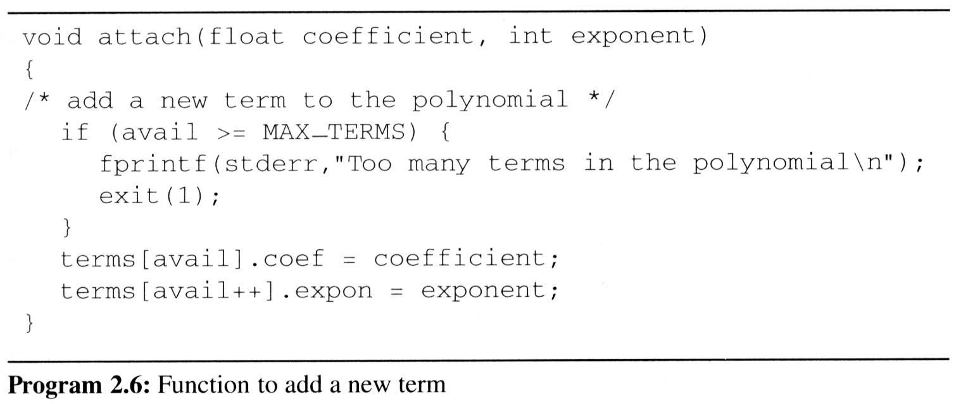
問題：陣列大小是有限的，當多項式總項數超過上限MAX_TERMS的時候需要壓縮
移動資料需要時間

Slide 28
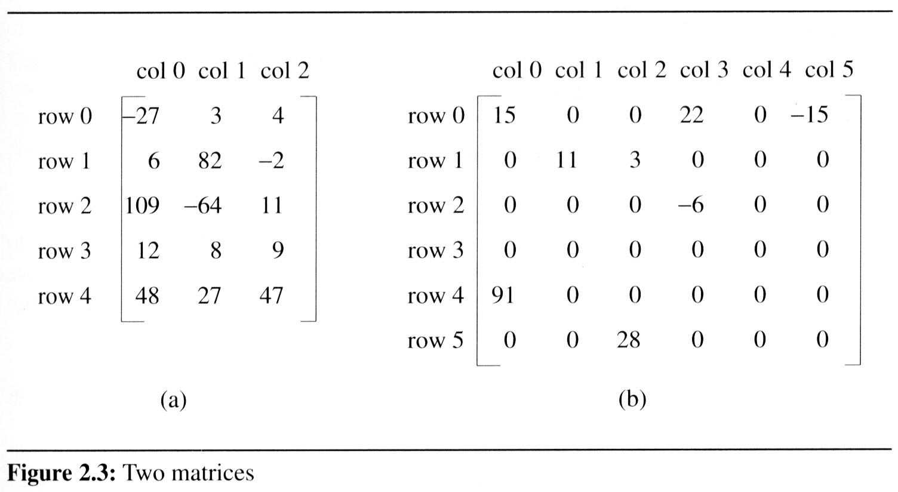
Sparce Matrix
思考：矩陣表示法&加法&乘法

Slide 29
Sparse Matrix
數學上，矩陣表示由m列(m rows) n行(n columns)個元素構成的資料型態，我們以mxn表示一個矩陣具有m rows and n cloumns
稀疏矩陣(Sparse Matrix)：0很多的矩陣
sparse matrix
data structure?
5*3
15/15
8/36
6*6

Slide 30
Sparse Matrix
最簡單的矩陣表示法是使用二維陣列(two dimensional array) defined as
a[MAX_ROWS][MAX_COLS]
簡單使用 a[i ][ j ] 即可存取任一位置
缺點：處理稀疏矩陣浪費空間
Hint：只儲存非零的元素？
Each element is characterized by <row, col, value>.

Slide 31
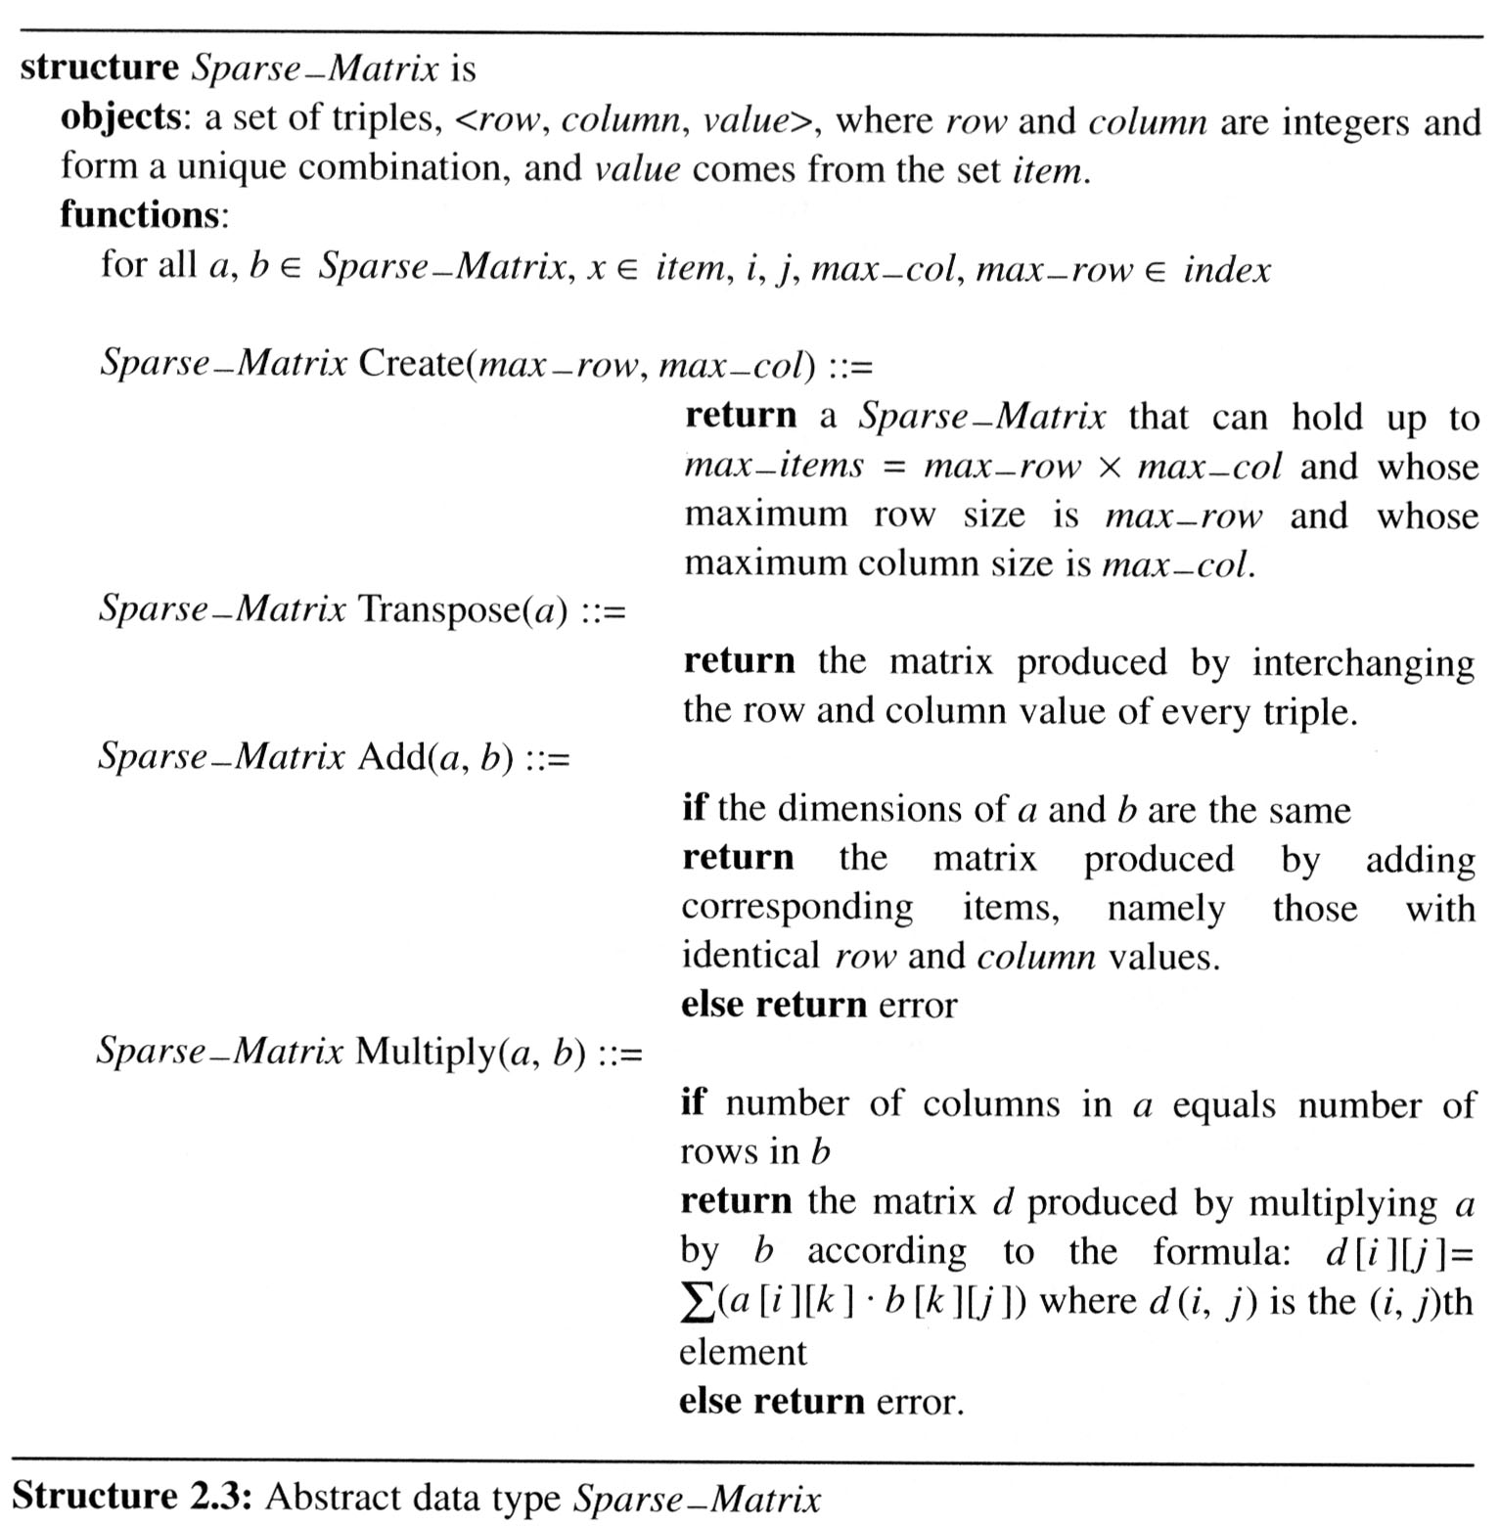
The Sparse Matrix ADT
Structure 2.3 contains our specification of the matrix ADT.
A minimal set of operations
Matrix creation
Addition
Multiplication
Transpose

Slide 32
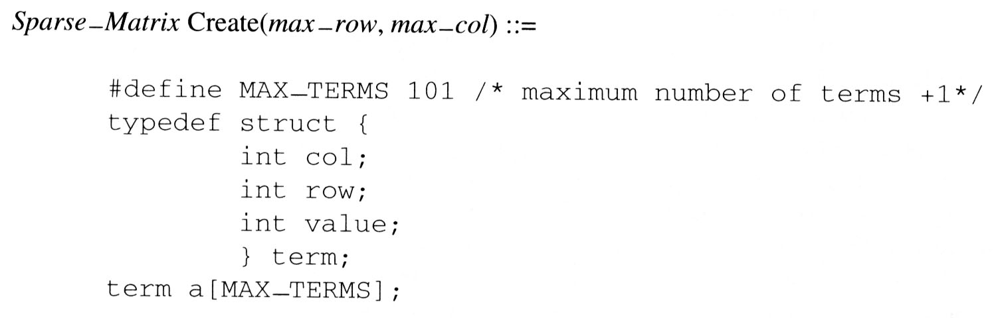
The Sparse Matrix ADT
建立矩陣：Create
對每個原本陣列的元素a[i,j]=x，我們需要一個三元數(triple)去儲存(i,j,x)，因此：
其中a[0].col = MAX_COL，a[0].row=MAX_ROW，a[0].value=NUM_OF_ELEMENTS

Slide 33
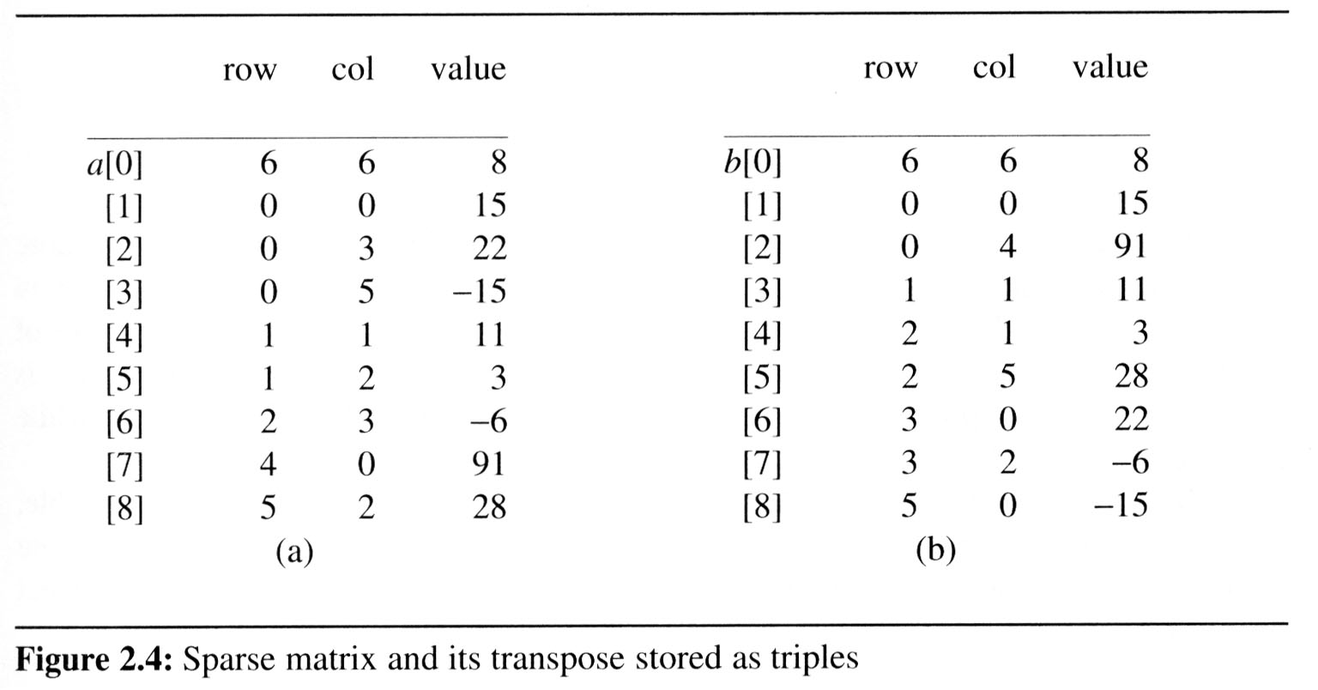
The Sparse Matrix ADT
Figure 2.4(a) shows how the sparse matrix of Figure 2.3(b) is represented in the array a[MAX_TERMS].
Each element is characterized by <row, col, value>.
# of rows (columns)
# of nonzero terms
transpose
row, column in ascending order

Slide 34
轉置矩陣Transpose
Transpose a Matrix
For each row i
take element <i, j, value> and store it in element <j, i, value> of the transpose.
difficulty: where to put <j, i, value> (0, 0, 15) ====> (0, 0, 15) (0, 3, 22) ====> (3, 0, 22) (0, 5, -15) ====> (5, 0, -15) (1, 1, 11) ====> (1, 1, 11) Move elements down very often.
For all elements in column j,
place element <i, j, value> in element <j, i, value>

Slide 35
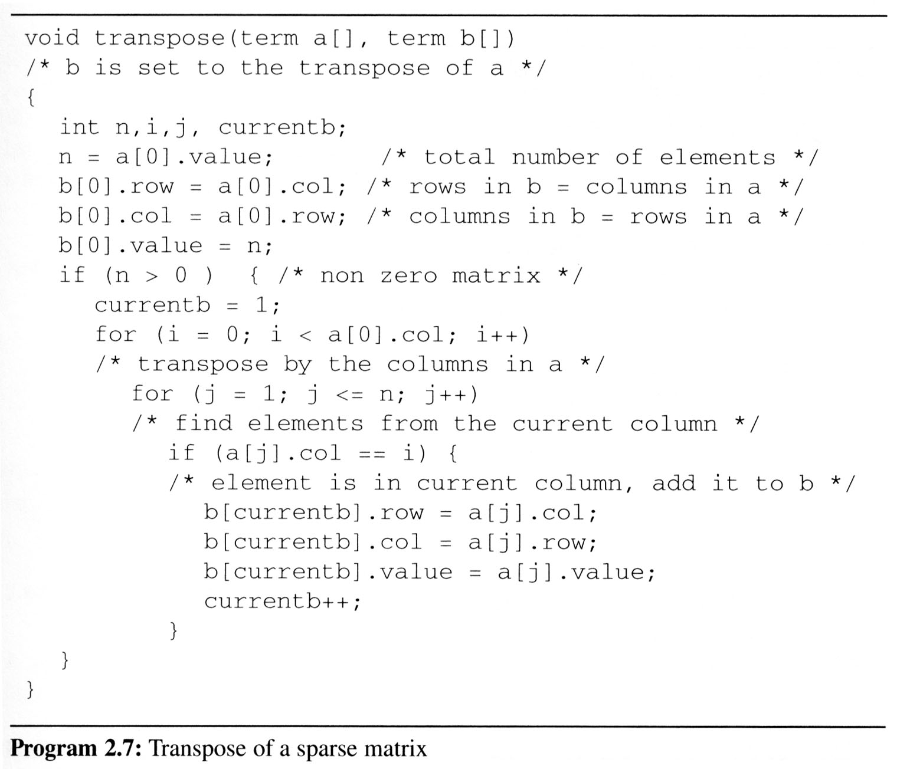
2.4 The sparse matrix ADT (7/18)
This algorithm is incorporated in transpose (Program 2.7).
Assign
A[i][j] to B[j][i]
place element <i, j, value> in element <j, i, value>
For all columns i
For all elements in column j
Scan the array “columns” times.
The array has “elements” elements.
==> O(columns*elements)

Slide 36
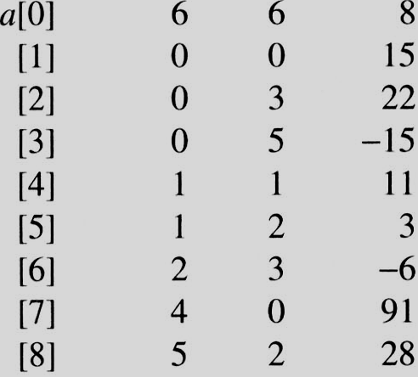
i=0 j=1
i=0 j=1
a[j]= 0 == i
i=0 j=2
i=0 j=2
a[j]=3 != i
i=0 j=3
i=0 j=3
a[j] = 5 != i
i=0 j=4
i=0 j=4
a[j].col = 1 a[j].col != i
i=0 j=5
i=0 j=5
a[j].col = 2 a[j].col != i
i=0 j=6
i=0 j=6
a[j].col = 3 != i
i=0 j=7
i=0 j=7
a[j].col = 0 == i
i=0 j=8
i=0 j=8
a[j].col = 2 != i
i=1 j=1
i=1 j=1
a[j].col = 0 != i
i=1 j=2
i=1 j=2
a[j].col = 3 != i
i=1 j=3
i=1 j=3
a[j].col = 5 != i
i=1 j=4
i=1 j=4
a[j].col = 1 == i
i=1 j=5
i=1 j=5
a[i].col = 2 != i
i=1 j=6
i=1 j=6
a[j].col = 3 != i
i=1 j=7
i=1 j=7
a[j] = 0 != i
i=1 j=8
EX: A[6][6] transpose to B[6][6]
i=1 j=8
a[i].col = 2 != i
Matrix A
Row Col Value
Set Up row & column in B[6][6]
Row Col Value
0 6 6 8
1 0 0 15
2 0 4 91
3 1 1 11
And So on…

Slide 37
2.4 The sparse matrix ADT (8/18)
和二維陣列表示法比較
O(columns*elements) vs. O(columns*rows)
elements --> columns * rows when non-sparse, O(columns²*rows)
問題：需要掃描整個陣列 “columns” 次.
In fact, we can transpose a matrix represented as a sequence of triples in O(columns + elements) time.
解決方法：
先計算每個column裡面到底有多少元素
接著找出轉置矩陣中，每一個元素的新的起始位置
(根據該行到底有幾個元素)

Slide 38
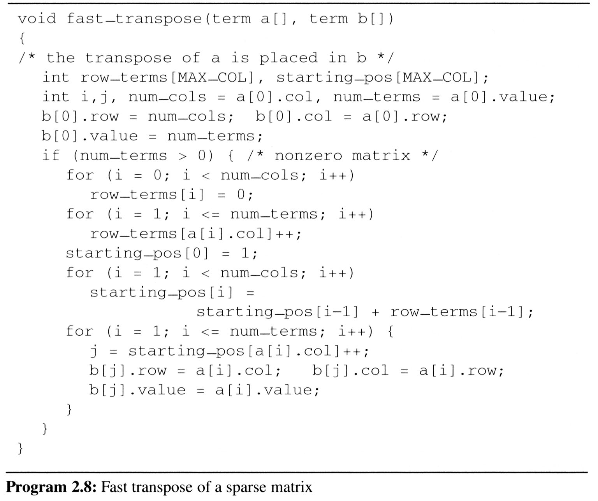
2.4 The sparse matrix ADT (9/18)
Compared with 2-D array representation: O(columns+elements) vs. O(columns*rows) elements --> columns * rows O(columns*rows)
Cost: Additional row_terms and starting_pos arrays are required.
Let the two arrays row_terms and starting_pos be shared.
For columns
Buildup row_term
& starting_pos
For elements
For columns
columns
transpose
For elements

Slide 39
2.4 The sparse matrix ADT (10/18)
After the execution of the third for loop, the values of row_terms and starting_pos are:
[0] [1] [2] [3] [4] [5] row_terms = 2 1 2 2 0 1 starting_pos = 1 3 4 6 8 8
transpose

Slide 40
[0] [1] [2] [3] [4] [5]
row_terms
0
1
2
0
1
0
1
2
0
0
0
1
1
#col = 6
#term = 6
2
Matrix A
Row Col Value
starting_pos
1
3
4
6
8
8

Slide 41
[0] [1] [2] [3] [4] [5] row_terms = 2 1 2 2 0 1 starting_pos = 1 3 4 6 8 8
[0] [1] [2] [3] [4] [5] row_terms = 2 1 2 2 0 1 starting_pos = 2 3 4 6 8 8
[0] [1] [2] [3] [4] [5] row_terms = 2 1 2 2 0 1 starting_pos = 2 3 4 7 8 8
[0] [1] [2] [3] [4] [5] row_terms = 2 1 2 2 0 1 starting_pos = 2 3 4 7 8 9
[0] [1] [2] [3] [4] [5] row_terms = 2 1 2 2 0 1 starting_pos = 2 4 4 7 8 9
[0] [1] [2] [3] [4] [5] row_terms = 2 1 2 2 0 1 starting_pos = 2 4 5 7 8 9
[0] [1] [2] [3] [4] [5] row_terms = 2 1 2 2 0 1 starting_pos = 2 4 5 8 8 9
[0] [1] [2] [3] [4] [5] row_terms = 2 1 2 2 0 1 starting_pos = 3 4 5 8 8 9
[0] [1] [2] [3] [4] [5] row_terms = 2 1 2 2 0 1 starting_pos = 3 4 6 8 8 9
I = 1
I = 2
I = 3
I = 4
I = 5
I = 6
I = 7
I = 8
Matrix A
Row Col Value
Row Col Value
0 6 6 8
1 0 0 15
2 0 4 91
3 1 1 11
4 2 1 3
5 2 5 28
6 3 0 22
7 3 2 -6
8 5 0 -15

Slide 42
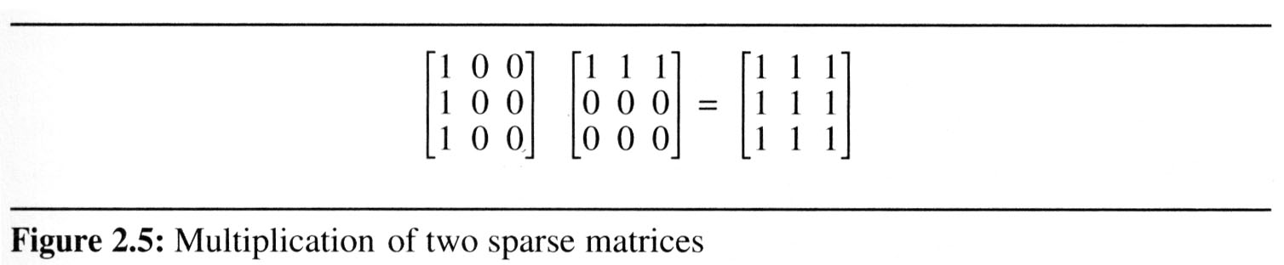
2.4 The sparse matrix ADT (11/18)
2.4.3 Matrix multiplication
Definition:
Given A and B where A is m×n and B is n×p, the product matrix D has dimension m×p. Its <i, j> element is
for 0 ≤ i < m and 0 ≤ j < p.
Example:

Slide 43
2.4 The sparse matrix ADT (12/18)
Sparse Matrix Multiplication
Definition: [D]_{m*p}=[A]_{m*n}* [B]_{n*p}
Procedure: Fix a row of A and find all elements in column j of B for j=0, 1, …, p-1.
Alternative 1. Scan all of B to find all elements in j.
Alternative 2. Compute the transpose of B. (Put all column elements consecutively)
Once we have located the elements of row i of A and column j of B we just do a merge operation similar to that used in the polynomial addition of 2.2

Slide 44
2.4 The sparse matrix ADT (13/18)
General case:
d_{ij}=a_{i0}*b_{0j}+a_{i1}*b_{1j}+…+a_{i(n-1)}*b_{(n-1)j}
Array A row i * Array J col j
可以想成Array row j * Array J轉置 row j
a a_{0*} d b_{*0}
b a_{1*} e b_{*1}
c a_{2*} f b_{*2}
g b_{*3}
The multiply operation generate entries:
a*d , a*e , a*f , a*g , b*d , b*e , b*f , b*g , c*d , c*e , c*f , c*g

Slide 45
The sparse matrix ADT (14/18)
An Example
A = 1 0 2 B^{T} = 3 -1 0 B = 3 0 2
-1 4 6 0 0 0 -1 0 0
2 0 5 0 0 5
a[0] 2 3 5 b_{t}[0] 3 3 4 b[0] 3 3 4
[1] 0 0 1 b_{t}[1] 0 0 3 b[1] 0 0 3
[2] 0 2 2 b_{t}[2] 0 1 -1 b[2] 0 2 2
[3] 1 0 -1 b_{t}[3] 2 0 2 b[3] 1 0 -1
[4] 1 1 4 b_{t}[4] 2 2 5 b[4] 2 2 5
[5] 1 2 6
row
col
value
row
col
value
row
col
value

Slide 46
An Example
A = 1 0 2 B^{T} = 3 -1 0 B = 3 0 2
-1 4 6 0 0 0 -1 0 0
2 0 5 0 0 5
a[0] 2 3 5 b_{t}[0] 3 3 4
[1] 0 0 1 b_{t}[1] 0 0 3
[2] 0 2 2 b_{t}[2] 0 1 -1
[3] 1 0 -1 b_{t}[3] 2 0 2
[4] 1 1 4 b_{t}[4] 2 2 5
[5] 1 2 6
row
col
value
row
col
value

Slide 47
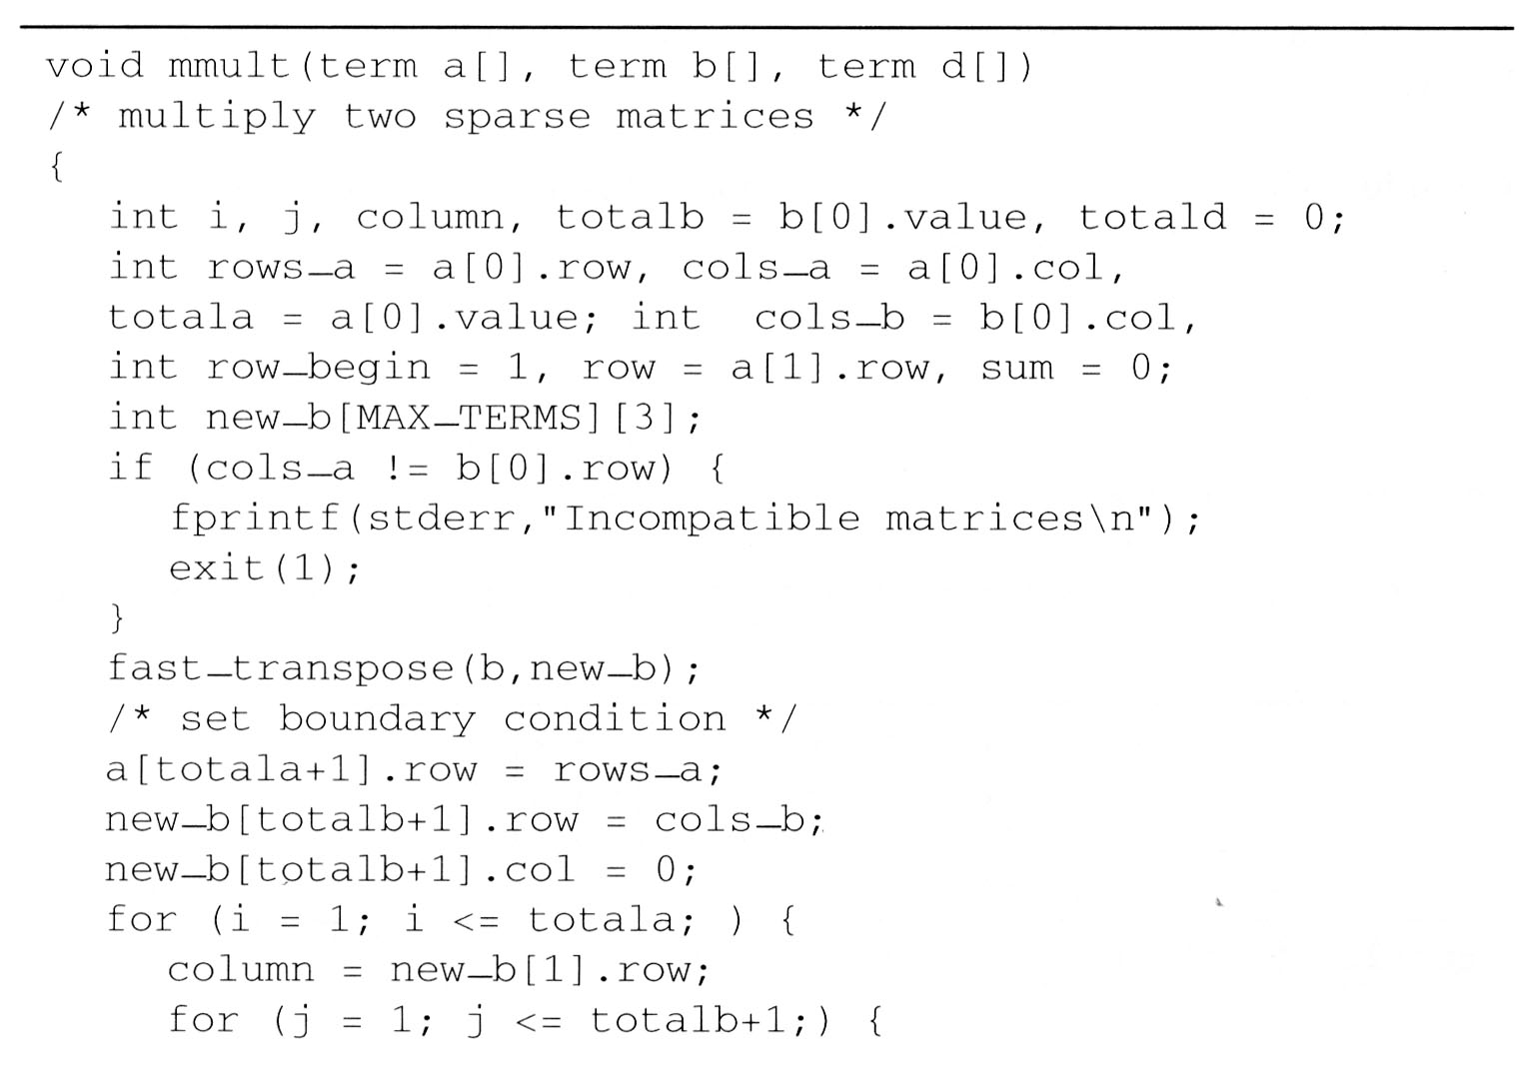
a[0] 2 3 5 b_{t}[0] 3 3 4 b[0] 3 3 4
[1] 0 0 1 b_{t}[1] 0 0 3 b[1] 0 0 3
[2] 0 2 2 b_{t}[2] 0 1 -1 b[2] 0 2 2
[3] 1 0 -1 b_{t}[3] 2 0 2 b[3] 1 0 -1
[4] 1 1 4 b_{t}[4] 2 2 5 b[4] 2 2 5
[5] 1 2 6
row
col
value
row
col
value
row
col
value
[5] 3 0
[6] 2
Totala = 5
A裡面的元素個數
B裡面的元素個數
D裡面的元素個數
row_a = 2 a的row數
cols_a = 3 a的cols數
cols_b = 3 b的cols數
目前要開始處理的row
是存在陣列第幾個位置(index)
目前要處理第幾行row
Totalb = 4
Totald = 0
rows_a = 2
cols_a = 3
cols_b = 3
row_begin = 1
row = 0

Slide 48
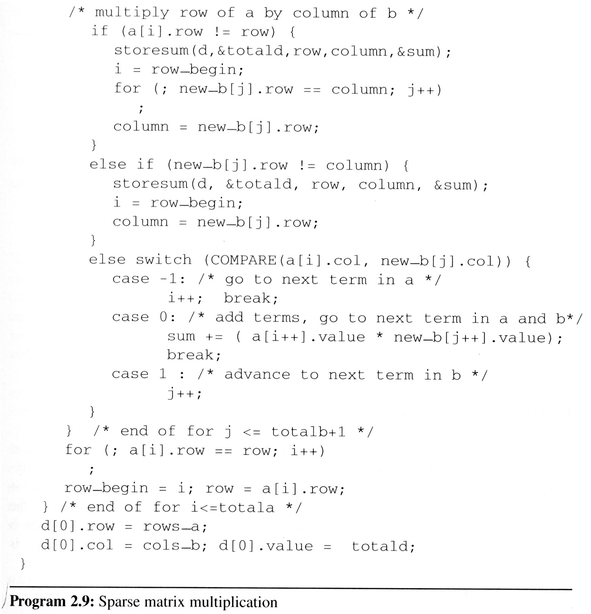
Totala = 5
rows_a = 2
row_begin = 1
Variable
Value
D
Totalb = 4
cols_a = 3
row = 0
3
2
i
1
2
1
2
3
cols_b = 3
1
Totald = 0
1
d[1] 0 0 3
2
j
7
3
4
5
6
0
d[2] 0 2 12
2
column
3
row
0
1
12
3
0
2
sum
0
row_begin
1
3
a[0] 2 3 5
[1] 0 0 1
[2] 0 2 2
[3] 1 0 -1
[4] 1 1 4
[5] 1 2 6
[6] 2
A[0][0]*B[0][0]
A[0][0]*B[0][2]
A[0][2]*B[2][2]
b_{t}[0] 3 3 4
b_{t}[1] 0 0 3
b_{t}[2] 0 1 -1
b_{t}[3] 2 0 2
b_{t}[4] 2 2 5
b_{t}[5] 3 0
And So on…

Slide 49
2.4 The sparse matrix ADT (15/18)
The programs 2.9 and 2.10 can obtain the product matrix D which multiplies matrices A and B.
a × b

Slide 50
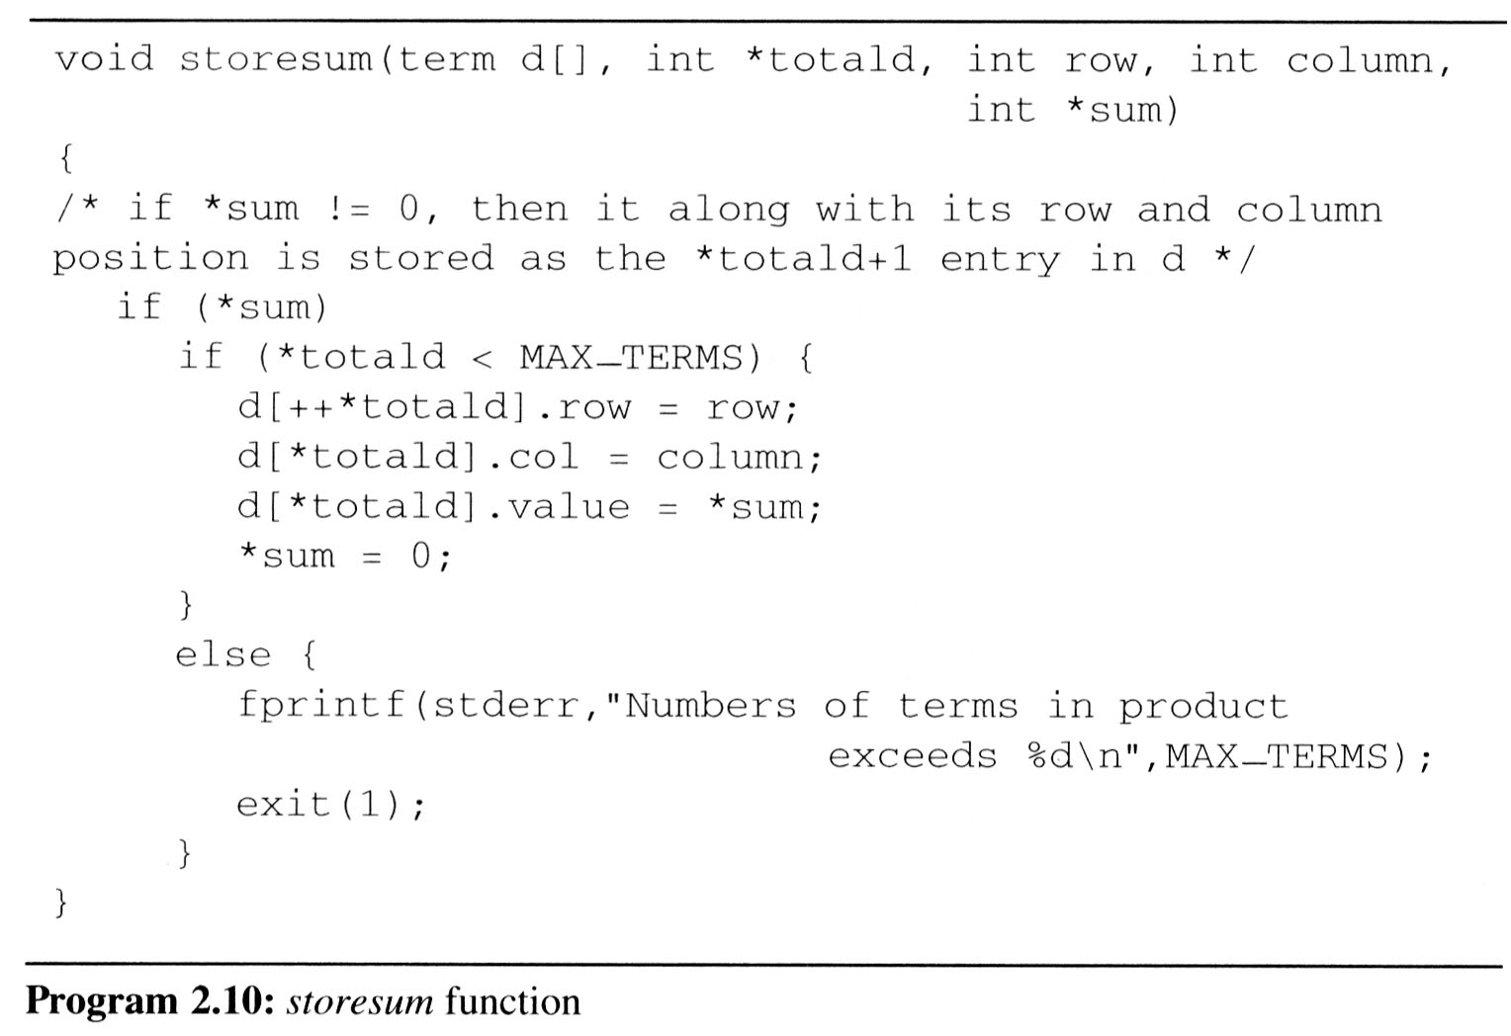
2.4 The sparse matrix ADT (16/18)

Slide 51


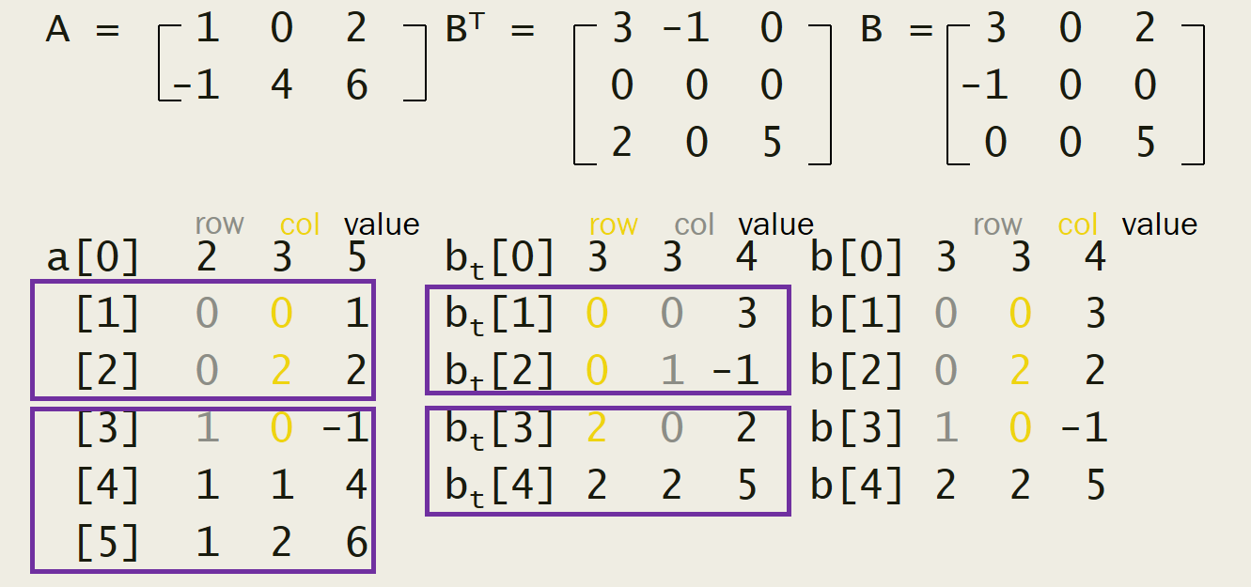
Analyzing the algorithm
cols_b * termsrow1 + totalb + cols_b * termsrow2 + totalb + … + cols_b * termsrowp + totalb = cols_b * (termsrow1 + termsrow2 + … + termsrowp)+ rows_a * totalb = cols_b * totala + row_a * totalb O(cols_b * totala + rows_a * totalb)

Slide 52
2.4 The sparse matrix ADT (18/18)
Compared with matrix multiplication using array
for (i =0; i < rows_a; i++) for (j=0; j < cols_b; j++) { sum =0; for (k=0; k < cols_a; k++) sum += (a[i][k] *b[k][j]); d[i][j] =sum; }
O(rows_a * cols_a * cols_b) vs. O(cols_b * total_a + rows_a * total_b)
optimal case: total_a < rows_a * cols_a total_b < cols_a * cols_b
worse case: total_a --> rows_a * cols_a, or total_b --> cols_a * cols_b

Slide 53
Practice
若陣列元素A(5,3)在記憶體位址是5314，而元素A(8,5)是在5422；假設每個元素占用四個位元組(Bytes)，請問元素A(2,7)的位址為？
(1) A(8,5) = A(5,3) + [(8-5)*n + (5-3)] * 4R
5422 = 5314 + 12n + 8 => 100 = 12n n = 100/12 …X
row-major
(2) A(8,5) = A(5,3) + [(5-3)*m + (8-5)] * 4
5422 = 5314 + 8m + 12 => 96=8m m = 12
A(2,7) = A(5,3) + [(7-3)*12 + (2-5)] * 4
= 5314 + [48-3]*4 = 5314+180 = 5494
column-major

